Slide 1
Opportunities for our Veterans
in the
Pest Management Industry

Slide 2
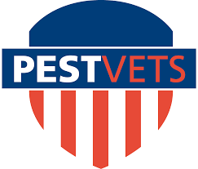
About PestVets
In 2014, members of the National Pest Management Association approached NPMA leadership regarding the creation of a Veteran’s Group in which returning veterans are provided resources about the opportunities available to them in the pest management industry.
PestVets four primary goals:
Create Veteran Awareness of Opportunities in the Pest Management Industry
Provide Guidance to Vets Transitioning with PestVets Mentorship Program
Service to Active Duty Military & Veterans at PestWorld and NPMA Legislative Day
Strengthen Our Industry’s Community of Veterans

Slide 3
Mission
NPMA is committed to engaging veterans in their successful transition to a productive and rewarding career in the pest management industry.
To that end, PestVets actively promotes the recruitment of veterans to member companies and supports those recruitment efforts through various education and training opportunities.
Mission Statement: To promote and support active and former service members within our industry while recruiting future veterans.
PestVets is sponsored by FMC. Through their generous support, PestVets has
already facilitated over many job opportunities for veterans across the country.

Slide 4
Reasons to Hire Vets
Accelerated learning curve: Veterans have the proven ability to learn new skills and concepts.
Leadership: The military trains people to lead by example as well as through direction, delegation, motivation, and inspiration.
Teamwork: Military duties involve a blend of individual and group productivity.
Diversity and inclusion in action: Veterans have learned to work side by side with individuals regardless of diverse race, gender, geographic origin, ethnic background, religion, and economic status as well as mental, physical, and attitudinal capabilities.
Respect for procedures: Veterans have gained a unique perspective on the value of accountability.
Integrity: Veterans know what it means to do “an honest day’s work”.

Slide 5
Work Opportunity Tax Credit (WOTC) – Hire a Veteran for your Pest Management Company
The Work Opportunity Tax Credit (WOTC) is a Federal tax credit available to employers for hiring individuals from certain target groups, including Veterans, who have consistently faced significant barriers to employment. In this case, hiring a Veteran will have a lower after-tax cost compared to hiring a non-WOTC eligible employee.
Renewed by Congress in December of 2019
Average of $2,400 credit claimed per hire
Contact jplevelich@pestworld.org or visit Pestvets.org to learn more

Slide 6
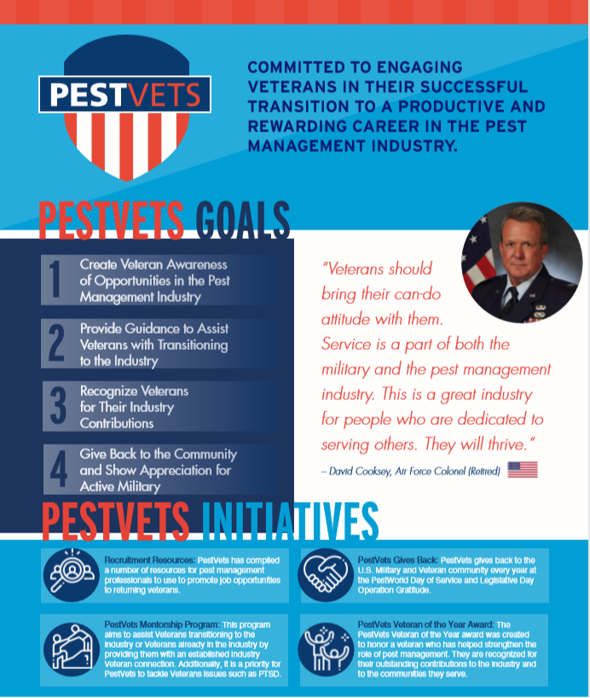
Goal # 1 - Create Veteran Awareness of Opportunities in the Pest Management Industry
Pestvets.org
PestVets Council advocating for hiring Veterans through national, state, and local associations.
Educating members of the pest control industry about benefits of hiring Veterans (ex. WOTC Tax Credit, Excellent Employees, etc.)
Creating State Chapters or “State PestVets Units” to raise awareness

Slide 7
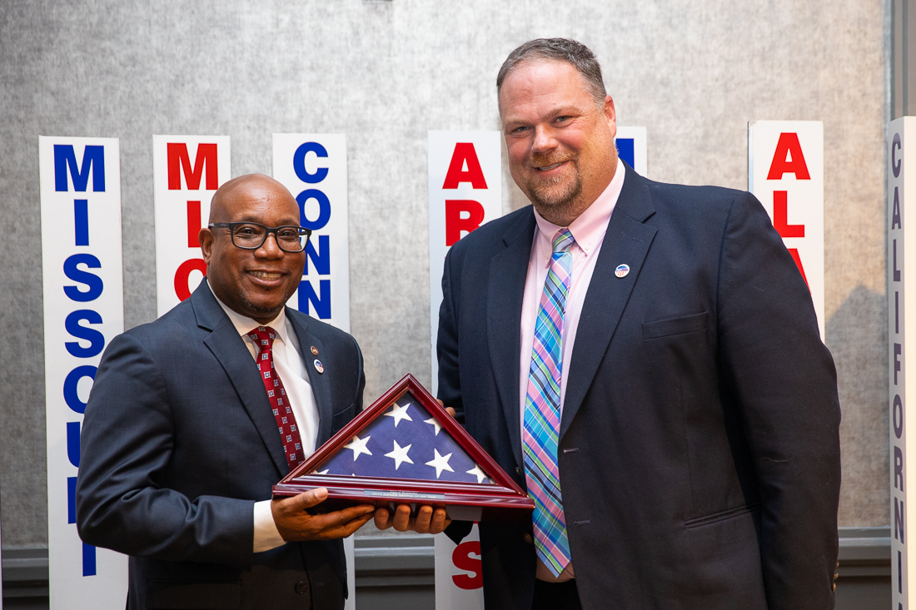
Goal # 2 - Provide Guidance to Vets Transitioning with PestVets Mentorship Program
David Cooksey
Air Force Colonel (Retired)
Reach out: DCooksey@mccallservice.com
Veterans in and outside of the industry are welcome to connect!
Dr. Stan Cope
Former Navy CAPT (Retired)
Reach out: scope@catchmaster.com

Slide 8
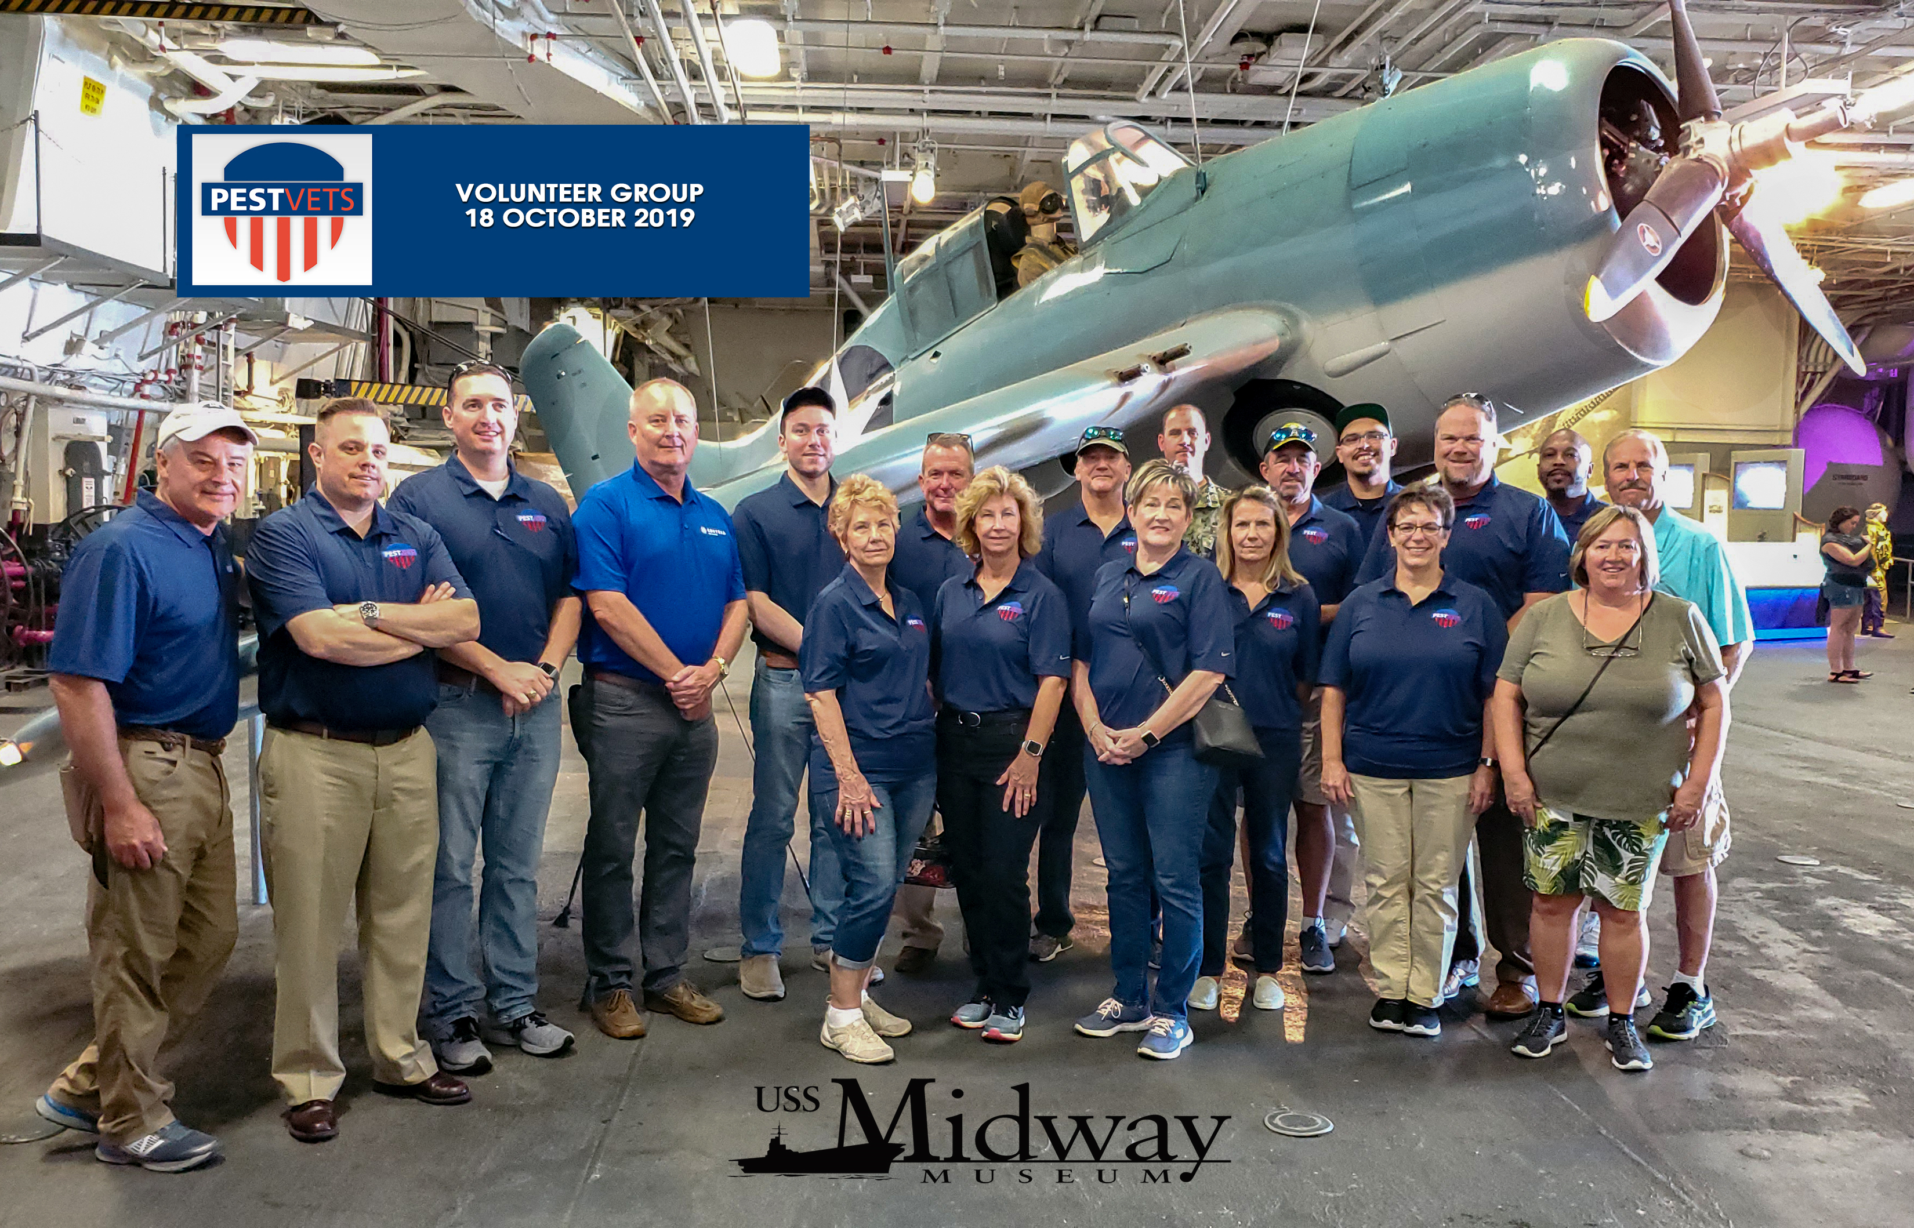
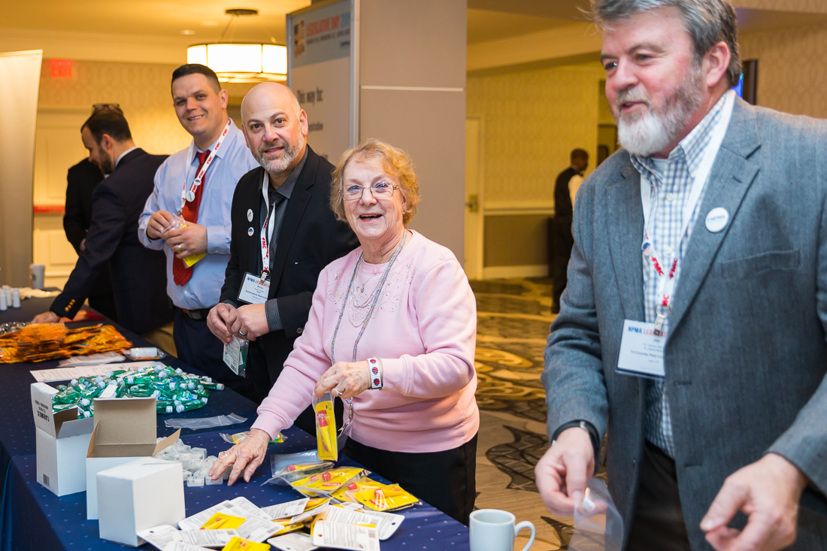
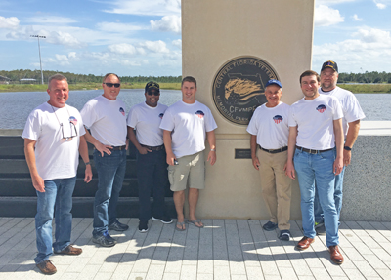
Goal #3 - Service to Active Duty Military & Veterans at PestWorld and NPMA Legislative Day
Stuffing care packages for active duty troops at NPMA Legislative Day and giving back to the active duty and Veteran communities at PestWorld.

Slide 9
Goal # 4 - Strengthen Our Industry’s Community of Veterans

Slide 10
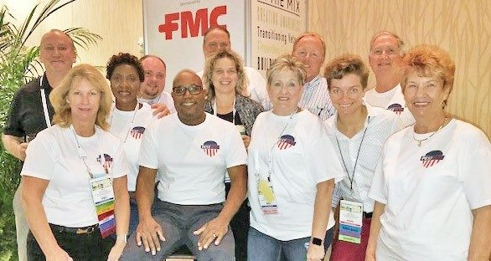
MORE INFORMATION: www.pestvets.org
Want to get involved with PestVets? There are a number of ways to do so:
Participate in PestVets! Don’t have to be a Vet!
Contact: Jake Plevelich – NPMA
jplevelich@pestworld.org
Honoring All Who Served

